Slide 1
Intro to Neural Nets
Week 5: Functional API

Slide 2
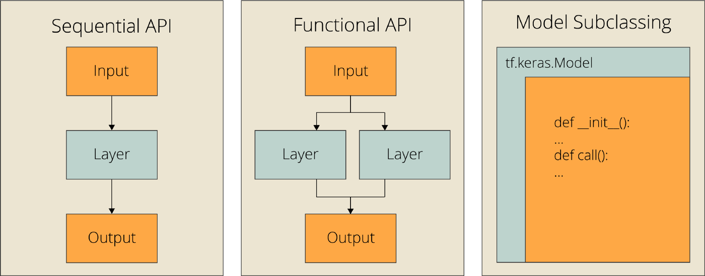
Today’s Agenda
Functional vs. Sequential API (vs. Subclassing)
Creating Keras models with the Sequential class vs. the Functional API
Custom Loss functions
Using TensorBoard to monitor training and evaluation metrics
Writing training and evaluation loops from scratch

Slide 3
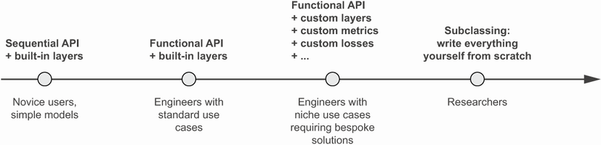
Alternative Options /w Keras

Slide 4
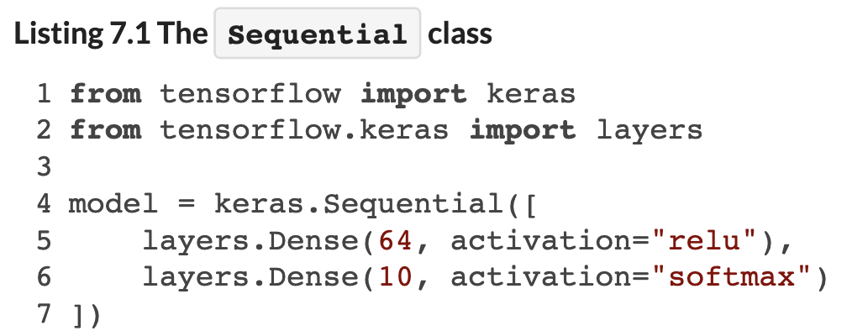
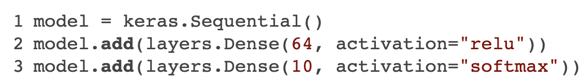
Sequential API: Topology
Same Thing, but Adding Layers Dynamically

Slide 5
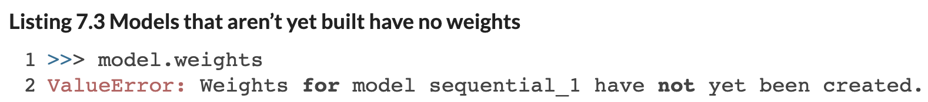
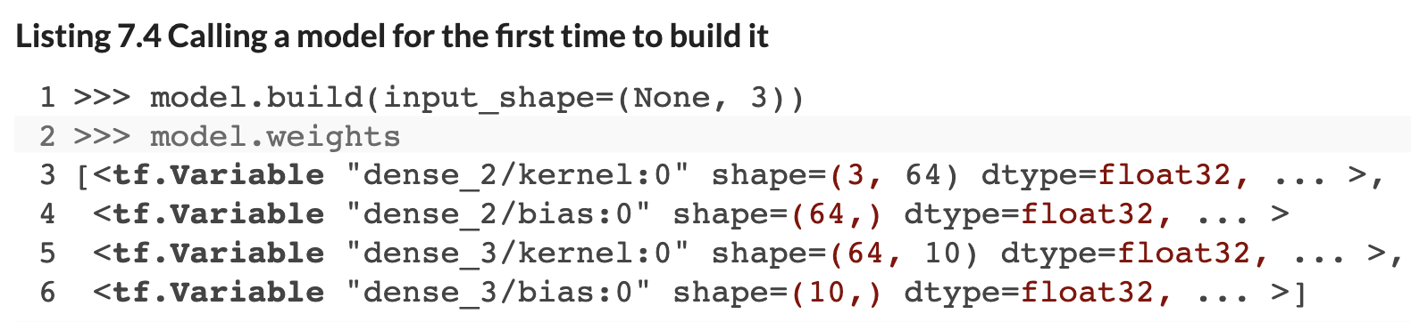
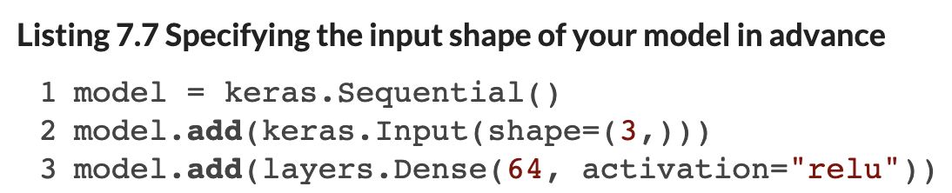
Sequential API: Initialization
Notes:
Weights are not initialized until you “build” the model (because Keras doesn’t know the shape of the inputs yet, it doesn’t have input weights defined). You can achieve this by either building the model, or by manually specifying the input layer (and its shape).

Slide 6
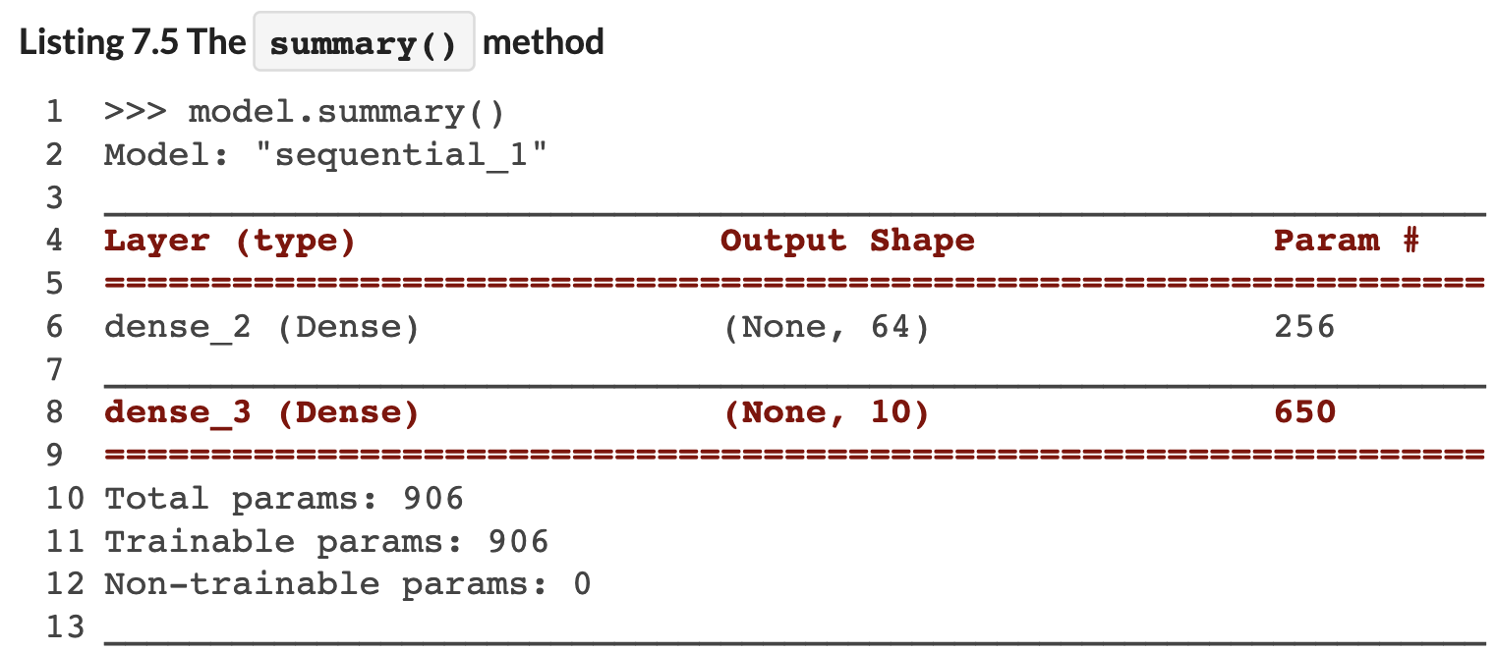
Sequential API: Summary
Notes:
Weights are not initialized until you “build” the model (or compile it, which will first build).

Slide 7
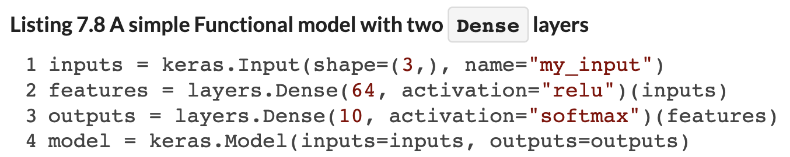
Functional API: Topology
Define Each Layer and its Linkages (If Any)
When you specify a given layer, you state what input it takes (if any).
This lets you build more complicated topologies (e.g., branches, multi-outputs, letting earlier layers feed into later layers in the network, and so on.

Slide 8
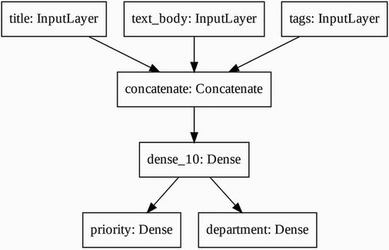
Complex Topologies
We Can Define a Multi-Input (Branches) to Multi-Output (Labels) Topology
This because useful for multi-modal data, or for introducing feedback loops, etc. into the network.
Notes:
Weights are not initialized until you “build” the model (or compile it, which will first build).

Slide 9
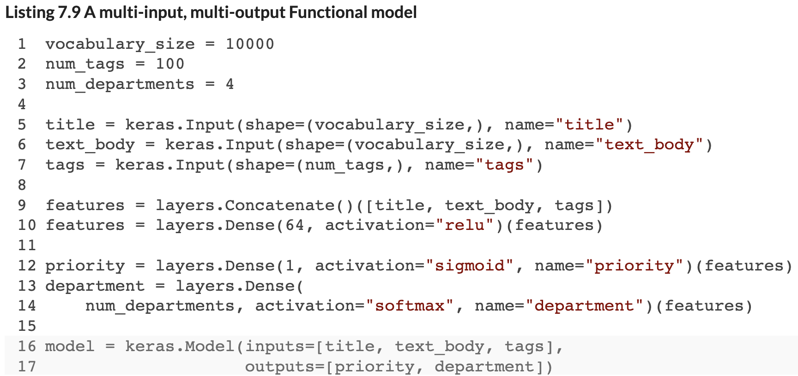
Complex Topologies
We Can Define a Multi-Input (Branches) to Multi-Output (Labels) Topology
This is useful for multi-modal data, residual links, or feedback loops, etc.
Notes:
Weights are not initialized until you “build” the model (or compile it, which will first build).

Slide 10
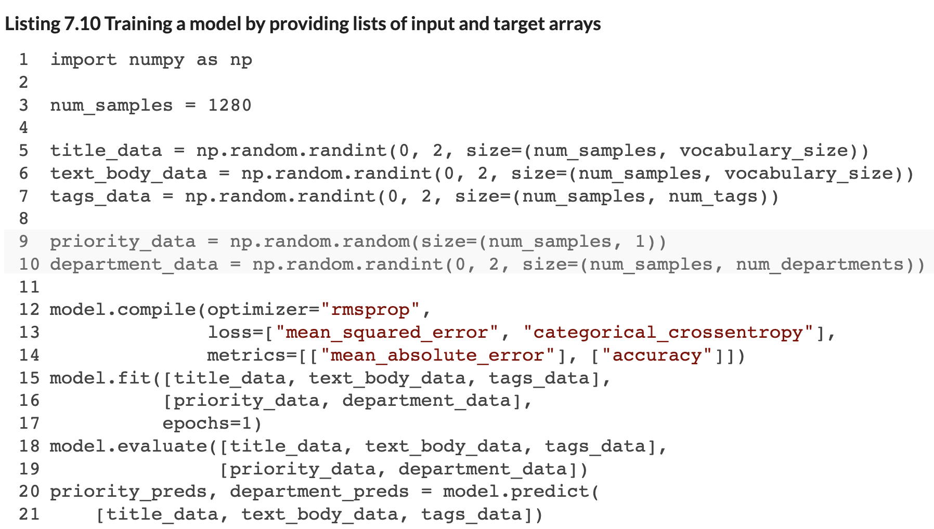
Functional API: Training
Pass Lists of Input Arrays, and Specify Lists of Loss Functions / Metrics
We need to pass in a list of arrays addressing all inputs, as well as a list of labels for all outputs.
We can also provide a list of loss functions and metrics, one of each for each output label.
Notes:
Weights are not initialized until you “build” the model (or compile it, which will first build).

Slide 11
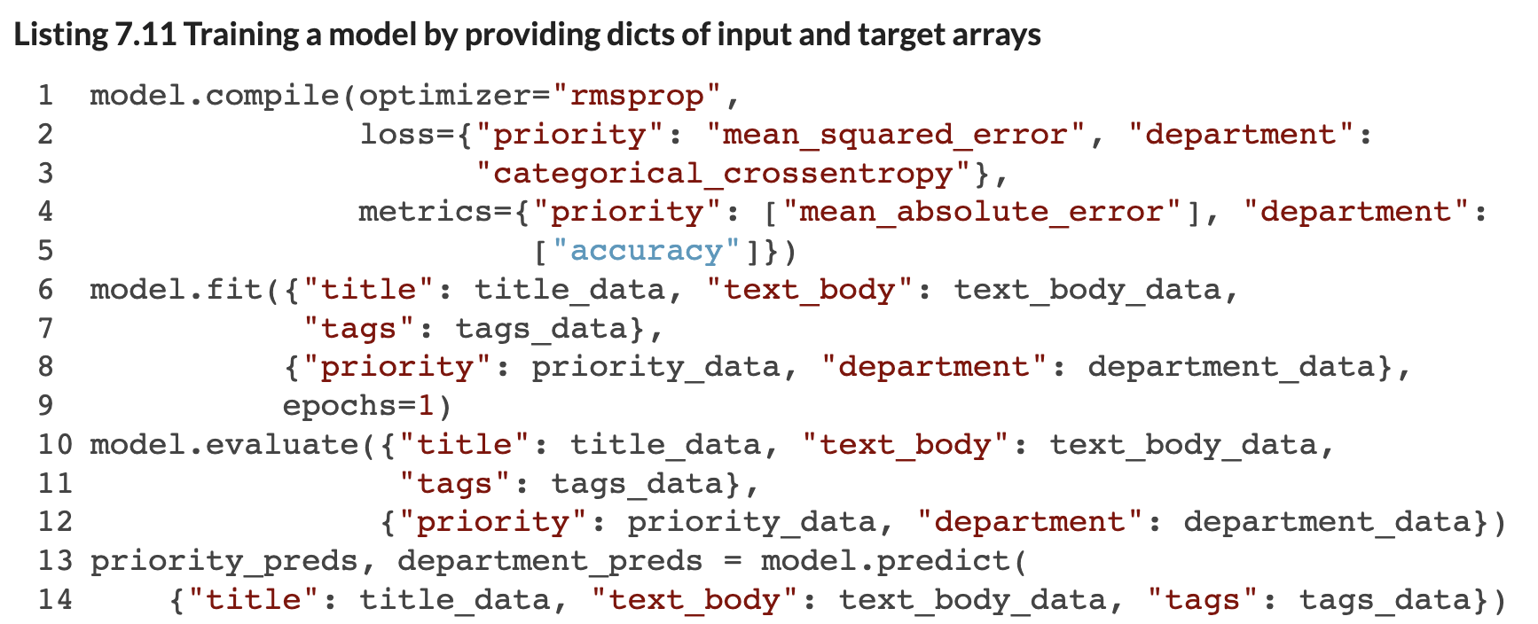
Functional API: Training
Pass Lists of Input Arrays, and Specify Lists of Loss Functions / Metrics
Use dictionaries rather than argument positional indexing (you are less likely to make a mistake this way!)
Notes:
Weights are not initialized until you “build” the model (or compile it, which will first build).

Slide 12
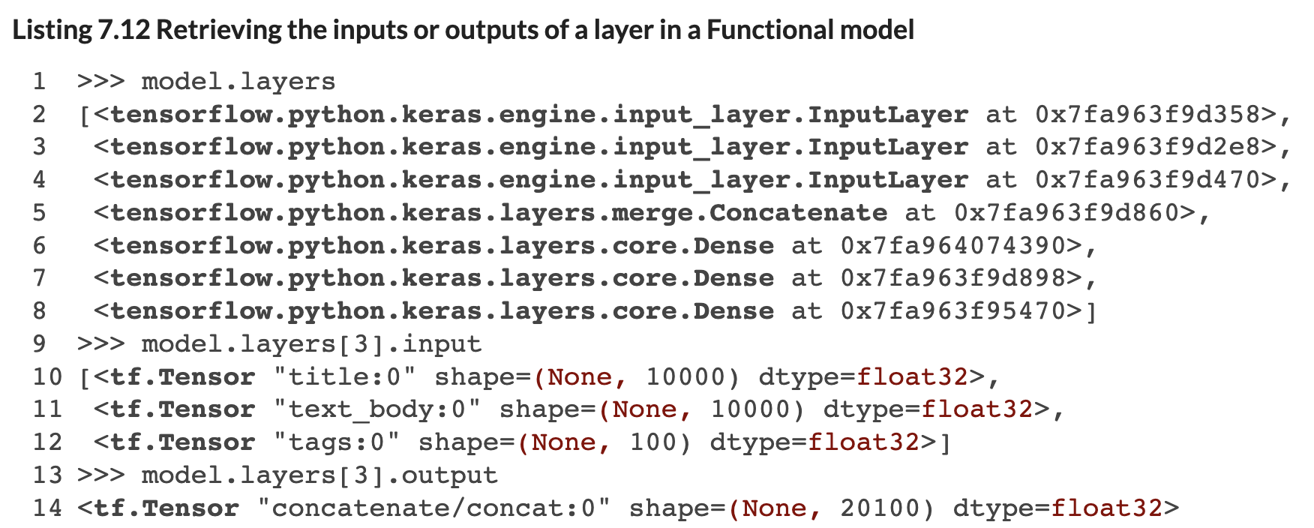
Functional API: Pre-Trained Weights
We Can Use Pre-Weights From Another Trained Model
Query the layer of an existing model, to extract its weights / bias term.
Then feed them into a new model.
Let’s Say We Want to Extract Weights from First Dense Layer…
Notes:
Weights are not initialized until you “build” the model (or compile it, which will first build).

Slide 13
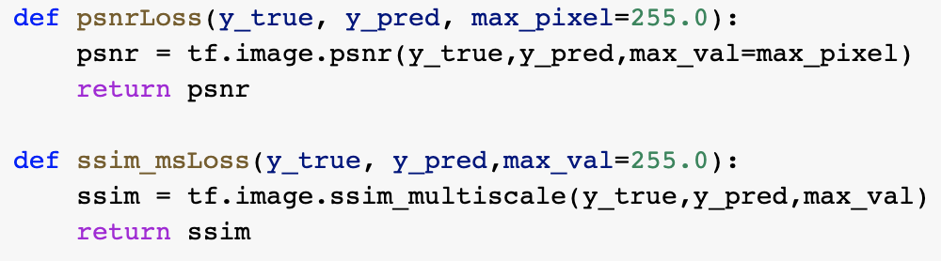
Custom Loss Functions
We Can Write a Custom Loss Function
Many application-specific situations where we might want a custom metric (or loss function).
One example I will show you is image-sharpening – MSE or MAE are okay, but there are better metrics for image-wide alignment of pixel values.
Function That Accepts Predicted and Actual as Input
Notes:
Weights are not initialized until you “build” the model (or compile it, which will first build).

Slide 14
Custom Loss Functions
We Can Write a Custom Loss Function
Many application-specific situations where we might want a custom metric (or loss function).
One example I will show you is image-sharpening – MSE or MAE are okay, but there are better metrics for image-wide alignment of pixel values.
Function That Accepts Predicted and Actual as Input
Notes:
Weights are not initialized until you “build” the model (or compile it, which will first build).

Slide 15
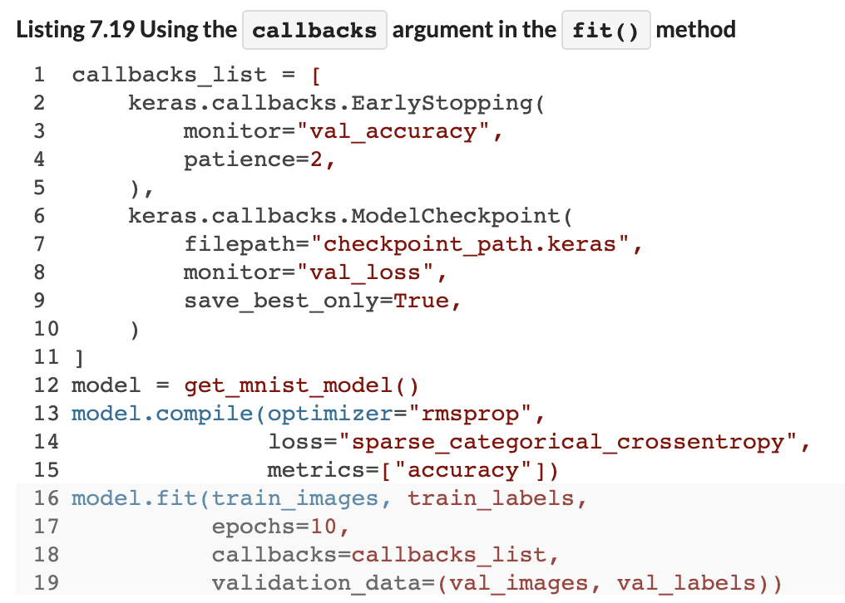
Callbacks in the Fit Method
We Can Enforce Some Rules During Fitting
For example, we can tell the fit method to stop the training process early based on < threshold improvements in our objective function.
Notes:
Weights are not initialized until you “build” the model (or compile it, which will first build).

Slide 16
Save / Load a Trained Model
We Can Save and Re-load Models with Trained Weights for Later Use
This enables transfer learning, picking up where we left off…
We might load an old model, extract the first 5 layers, and then stack new layers on the end.
We might also fix the old model’s layers as non-trainable (‘calibrate’ a new model ‘end’ on top of the pre-trained model).
More on this shortly…
Notes:
Weights are not initialized until you “build” the model (or compile it, which will first build).

Slide 17
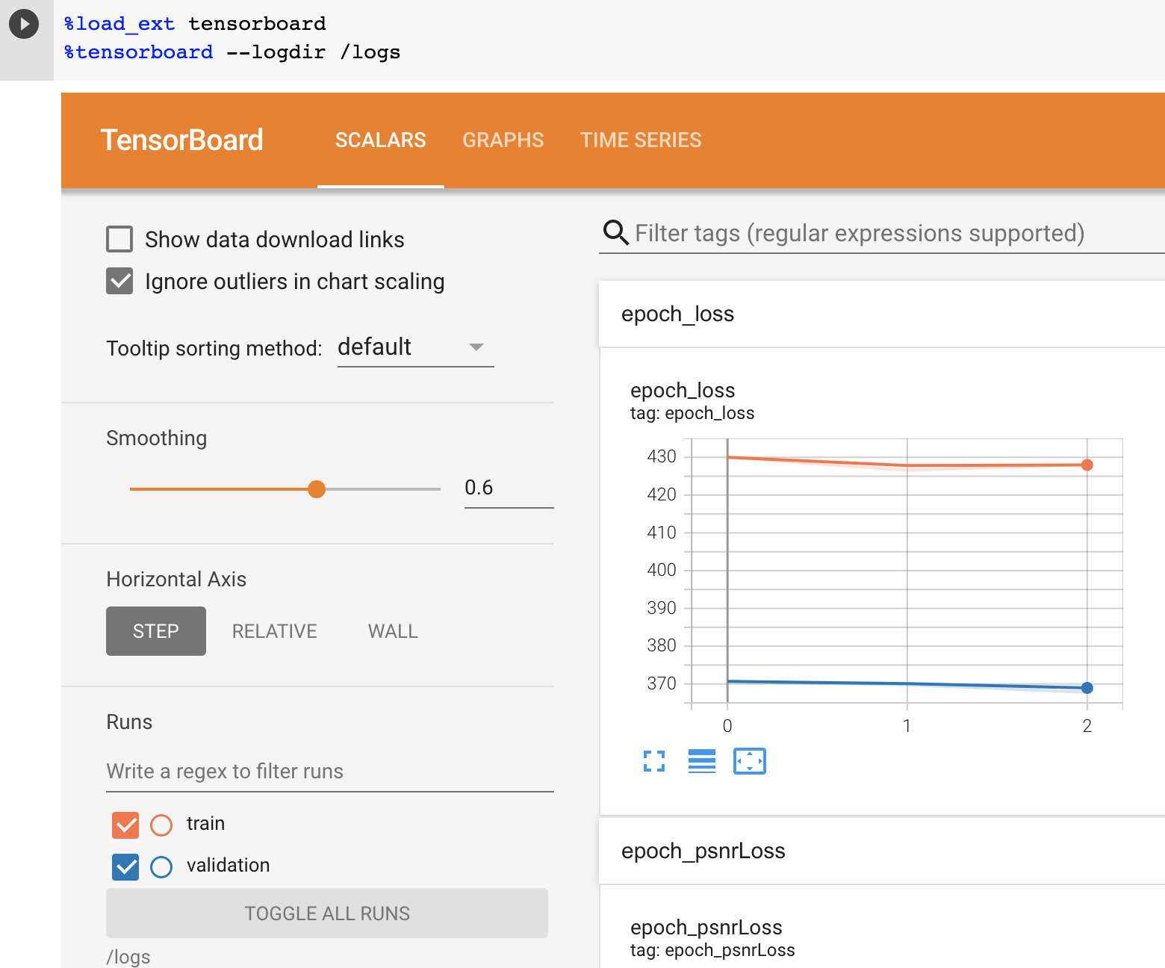
Tensorboard
Load in Keras, then add Callback to model.fit()
Notes:
Weights are not initialized until you “build” the model (or compile it, which will first build).

Slide 18
Questions?
Notes:
Weights are not initialized until you “build” the model (or compile it, which will first build).

